Slide 1
Building Health Systems to Deliver People-centered Health Services
Dr. David Sergeenko
Minister of Internally Displaced Persons from Occupied Territories, Labour, Health, and Social Affairs of Georgia

Slide 2
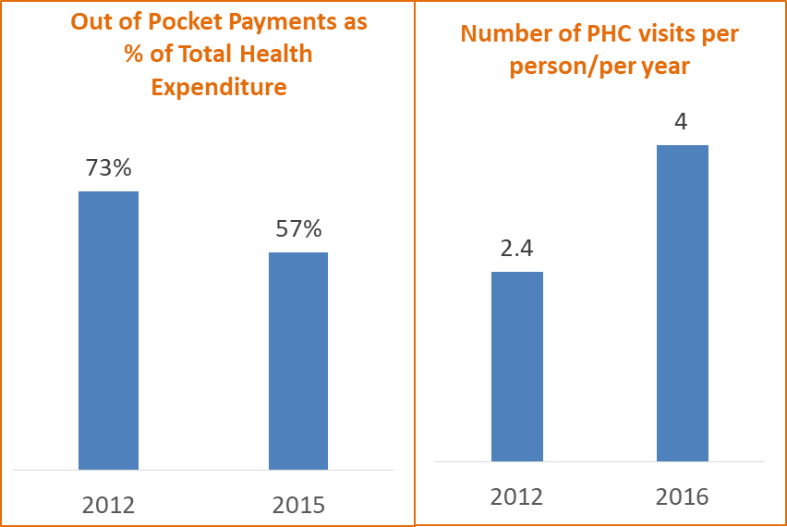
Universal Health Care Program
Initiated in 2012, Operational from 2013
GOAL of Georgian UHC Program:
To improve access to quality health care for all citizens of Georgia through removing financial barriers and improving quality of services delivered
UHCP is aligned with SDGs and
WHO/Europe/Health 2020

Slide 3
Georgia
Characteristic | n | % | Estimated # nationwide ≥18 years
HIV + | 5090 | 48% | 10,500
Anti-HCV+ | 433 | 7.7% | 215,000
HCV RNA+ | 311 | 5.4% | 150,000
The country of Georgia has low level HIV epidemic, but high burden of hepatitis C virus (HCV) infection. The nationwide seroprevalence survey conducted in 2015, indicated 5.4% of adults (approximately 150,000 persons) with active HCV infection (RNA positive).
HIV national prevalence is 0.4%, estimated number of PLHIV is 10,500 (2017)
The universal access to HIV and TB diagnostic and treatment services is guaranteed for all people living with the diseases since 2004 and 2005 with support of the Global Fund.
Small size of the country (69,700 sq. m) with population of 3.7 million people
Strong Government Commitment towards elimination of HCV and HIV
TGF Programs created solid foundation for effective HIV/HCV/TB Programs
The Global Fund’s HIV program was instrumental for building effective virology diagnostic and service delivery systems and relevant HRs in Georgia
Existence of effective systems for implementation of large-scale national and international health programs and partnerships, including multi-sectoral mechanisms.
Georgia was the first country in EECA region that started pegilated interferon HCV treatment among HIV/HCV co-infected patients with support of the Global Fund in 2011.
Adherence to principles of evidence based medicine and established logistics and control mechanisms within HIV and TB programs

Slide 4
Targets
First National HIV Strategic Plan (NSP) was developed in 2001 in Georgia
The NSP is updated regularly with 3 year cycles
New NSP is drafted for 2019-2022
Reaching UNAIDS HIV FAST TRACK Targets By 2020
90% of people living with HIV are diagnosed
90% of those diagnosed are enrolled in treatment
90% of those who are on treatment have virus suppressed
CCM approved Draft
Elimination of hepatitis C infection in Georgia by 2020
90% of people living with HCV are diagnosed
95% of those diagnosed are treated
95% of those treated are cured
90-95-95
Approved on August 18, 2016

Slide 5
Road Towards HCV Elimination – 1/3 of the population (1,2 million people) is screened on anti-HCV 48,000 people (35% of target) are enrolled in treatment
Patient inclusion criteria removed
Long-term Elimination
Strategy 2016-2020 approved
Geographic and financial access to
diagnostic services - significantly increased
2016
2018
LDV/SOF based regimens
introduced to the program
Moving from vertical to horizontal service delivery systems through active engagement of PHC centers
TAG established
Decentralization of HCV services
Overall SVR rate 98%
Elimination through Decentralization
2nd World Hepatitis Summit
World Hepatitis Summit
Enhancement of electronic information systems
Memorandum of Understanding between Georgian Government and Gilead Sciences
HCV Screening Protocol approved by the Ministry
2015
2017
Initial phase of HCV elimination action plan
TAG recommendation on decentralization

Slide 6
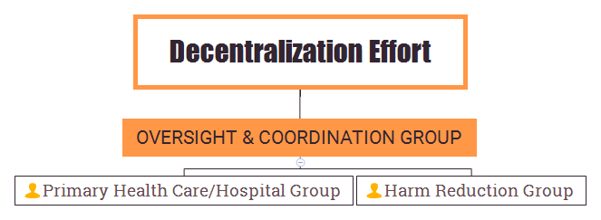
Decentralization Concept
Working Groups Established
Action Plan for Decentralization
Launch of program by June 2018
Progress report for TAG 2018

Slide 7
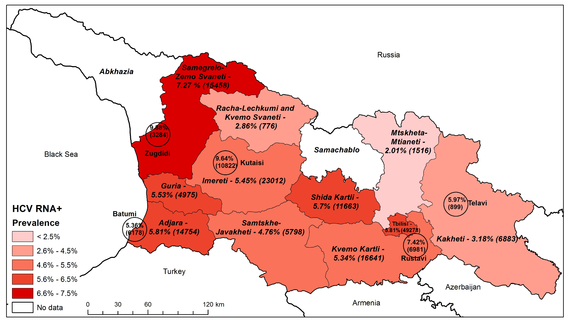
Decentralization Concept
Up to 70 Sites
After Decentralization
32 sites by October, 2017
4 Sites
(launch of the program in April 2015)

Slide 8
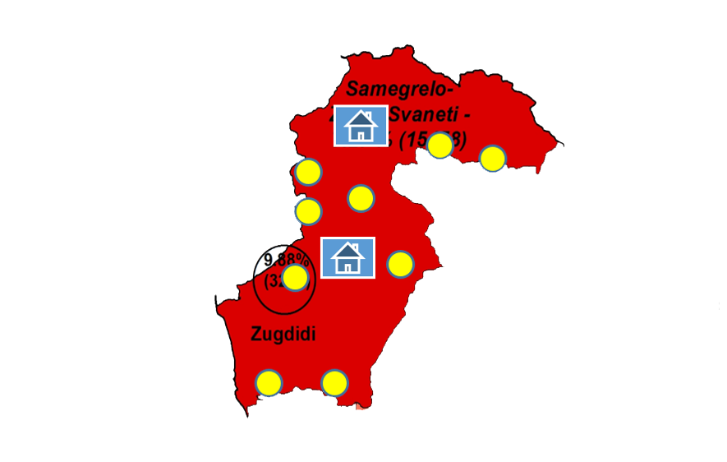
Three Diseases (HIV/HCV/TB) Under One Umbrella
Pilot project in Samegrelo-Zemo Svaneti Region was lunched in November, 2017
HCV Prevalence – 7,27% (HCV RNA+)
Estimated number of HCV RNA+ 15,458
TB Prevalence - 113 (100,000 population)
Number of notified cases – 373
HIV/AIDS Prevalence – 208 (100,000 population)
Number of cases - 868
Decentralization of integrated screening and detection of TB/HIV/HCV at primary health care settings
Implementation
progress
350 HCV screening points (PHC clinics and village physicians)
Integrated TB/HIC/HCV screening protocol approved
454 doctors and nurses trained
Integrated multidisciplinary service monitoring groups established
Municipal programs supporting pilot implementation approved
Target for HCV testing - 40% of local population
Currently 35,600 persons are screened on HCV and HIV, anti-HCV+ 1,411(3%), anti-HIV+ 21 case

Slide 9
Conclusion
HCV Elimination program is major driver for Health System Strengthening and advancing Public Health Agenda in Georgia, especially for HIV and TB. HCV elimination program supports the development of other key public health programs such as Safe Blood, Infection Control, Harm Reduction, etc.
In the first 30 months of the HCV Elimination Program, Georgia has scaled up the screening and treatment services achieving impressive results - 35% treatment coverage with 98% cure rate
Enhancing HCV and HIV tandem testing and linkage to care and treatment services are critical to reaching the 2020 HCV elimination and 2020 HIV Task Track goals
Provision of HCV and HIV screening, confirmation, care and treatment services at non-specialized settings nearer to patients’ homes is critical for achieving the elimination goals
Decentralization and integration of HCV/HIV/TB services’ delivery in primary care or harm reduction settings can result in overcoming barriers to access care and treatment
Lessons learned from the Georgia elimination program can inform programs in other countries striving to eliminate HCV and end HIV epidemic as a public health threat.

Slide 10
Acknowledgements
US Centers for Disease Control and Prevention (CDC)
Gilead Sciences, Inc.
WHO, WHO Euro
TAG Members
LIFER
ECHO
World Hepatitis Alliance
Nohep Movement
Ministry of Labour, Health and Social Affairs
National Center for Disease Control and Public Health
HCV Service Centers

